Slide 1
WEEKLY PRESENTATION

Slide 2
agenda
MANUAL TESTING
API TESTING

Slide 3
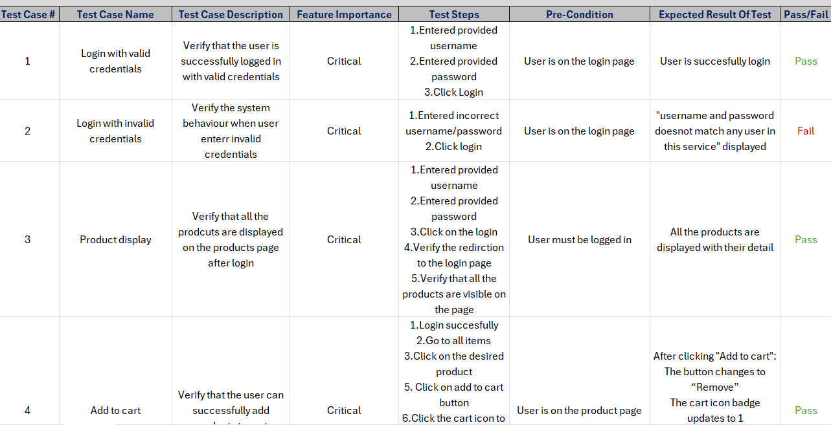
TEST CASES
I have tested 8 (6 pass and 2 fail) functionalities of Swag labs include login, product display, add to cart, checkout and logout

Slide 4
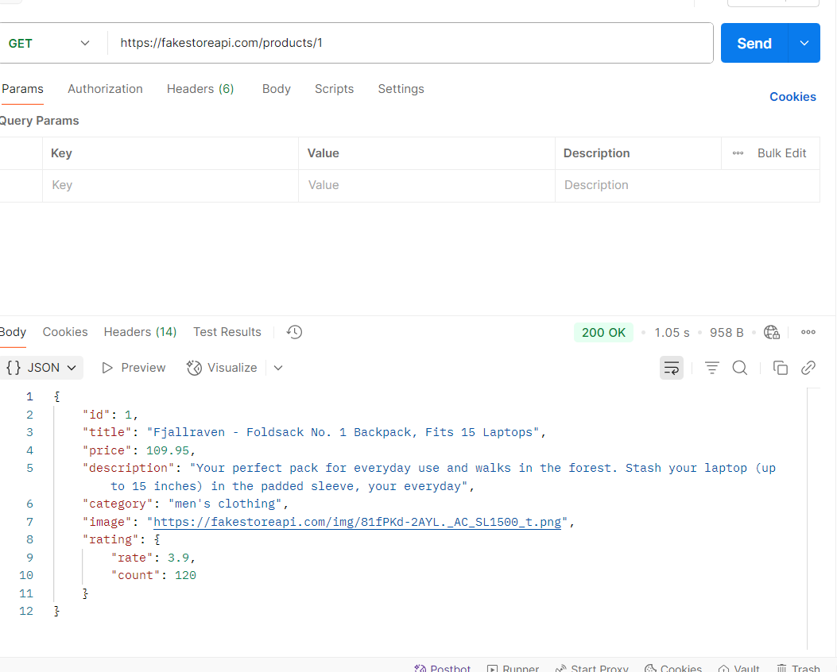
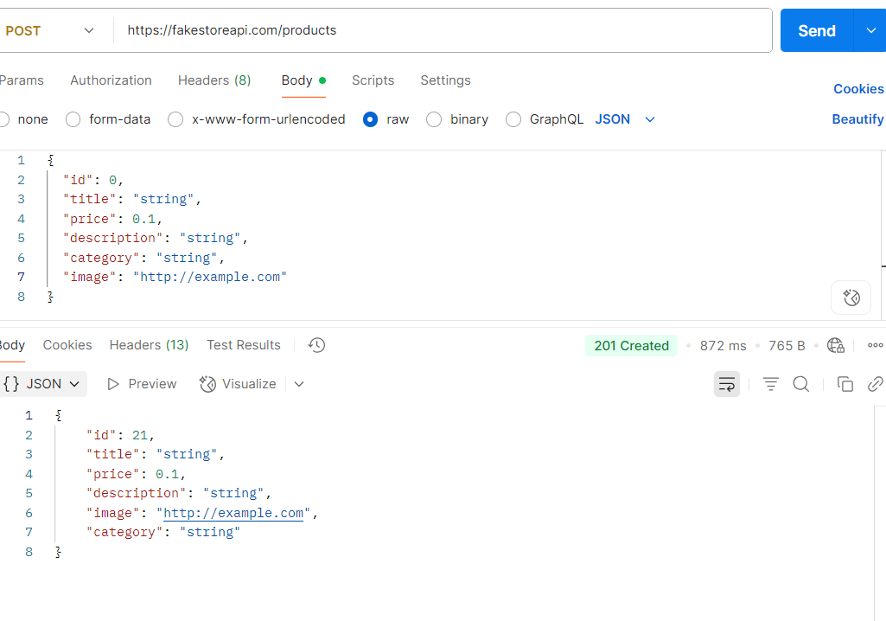
API TESTING
GET REQUEST
POST REQUEST

Slide 5
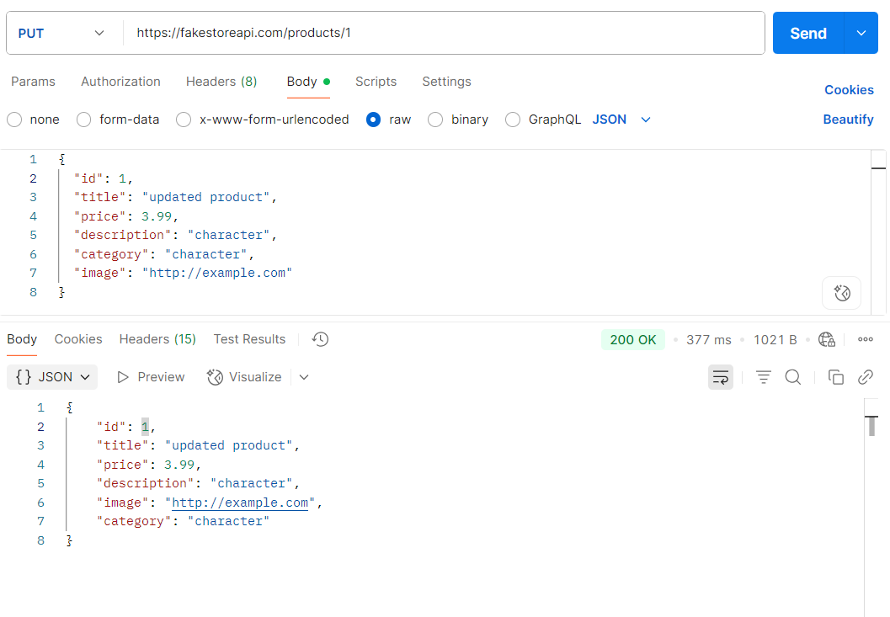
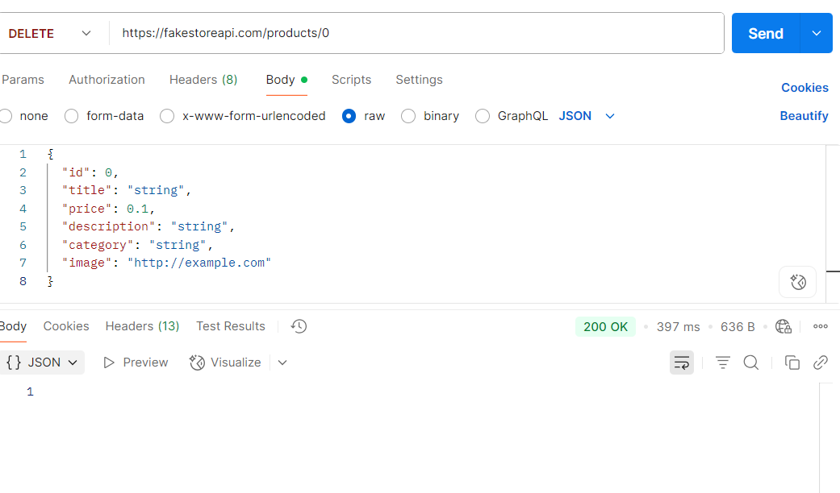
API TESTING
PUT REQUEST
DELETE REQUEST

Slide 6
thank you

